Slide 1


making your life easier
+
*
Brian Maitner (modified by Nick Smith for biol 4350/6350)
*(if you study plants)

Slide 2
Introduction
Some Big Questions in Ecology and Evolution:
What drives species richness patterns?
How have traits evolved within and across taxa?
What controls functional diversity?
How will climate change impact communities?

Slide 3
Introduction
Some Big Questions in Ecology and Evolution:
What drives species richness patterns?
How have traits evolved within and across taxa?
What controls functional diversity?
How will climate change impact communities?
Answering these will require BIG Data!

Slide 4
Introduction
Big Data in Ecology?
Lagging behind genetics (GenBank)
Lots of data, but not served very usefully (or at all)
Big, bad data (e.g. GBIF)
50% of plant names wrong
Only 33% of plant coordinates verifiably correct

Slide 5

Introduction
Big Data in Ecology?
What we need:
Open Access
Standardization
Conglomeration
Error checking

Slide 6
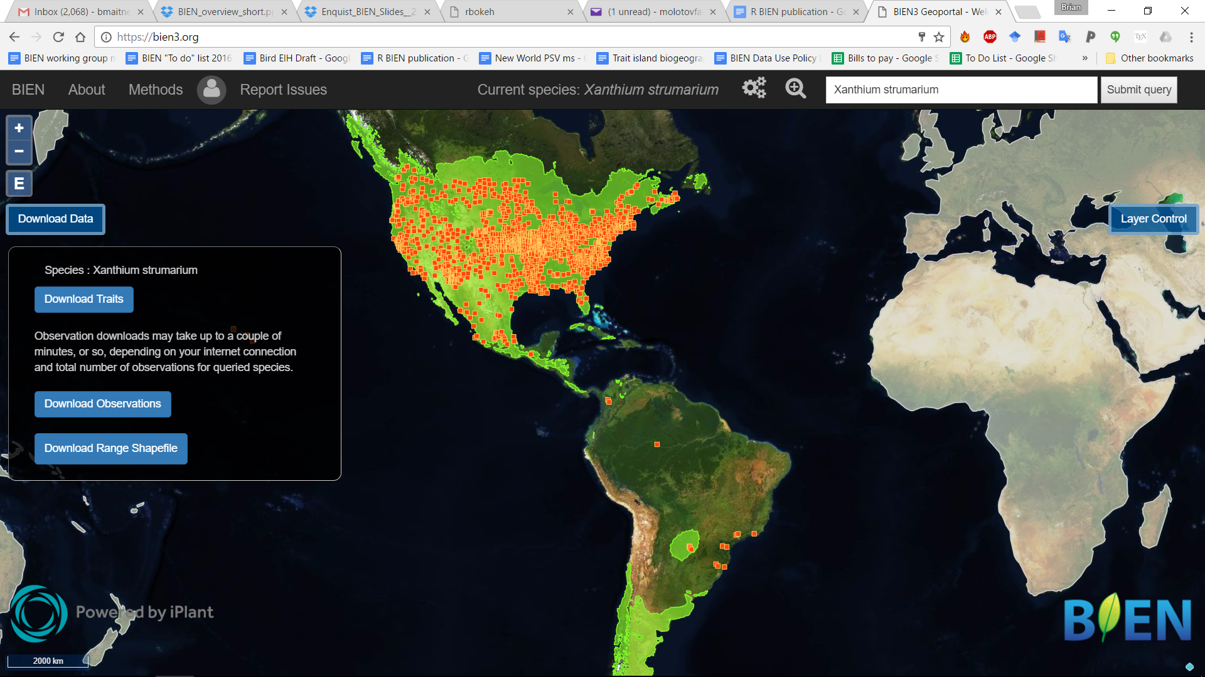
Introduction
Big Data in Ecology?
What we need:
Open Access
Standardization
Conglomeration
Error checking
This is where BIEN comes in!

Slide 7
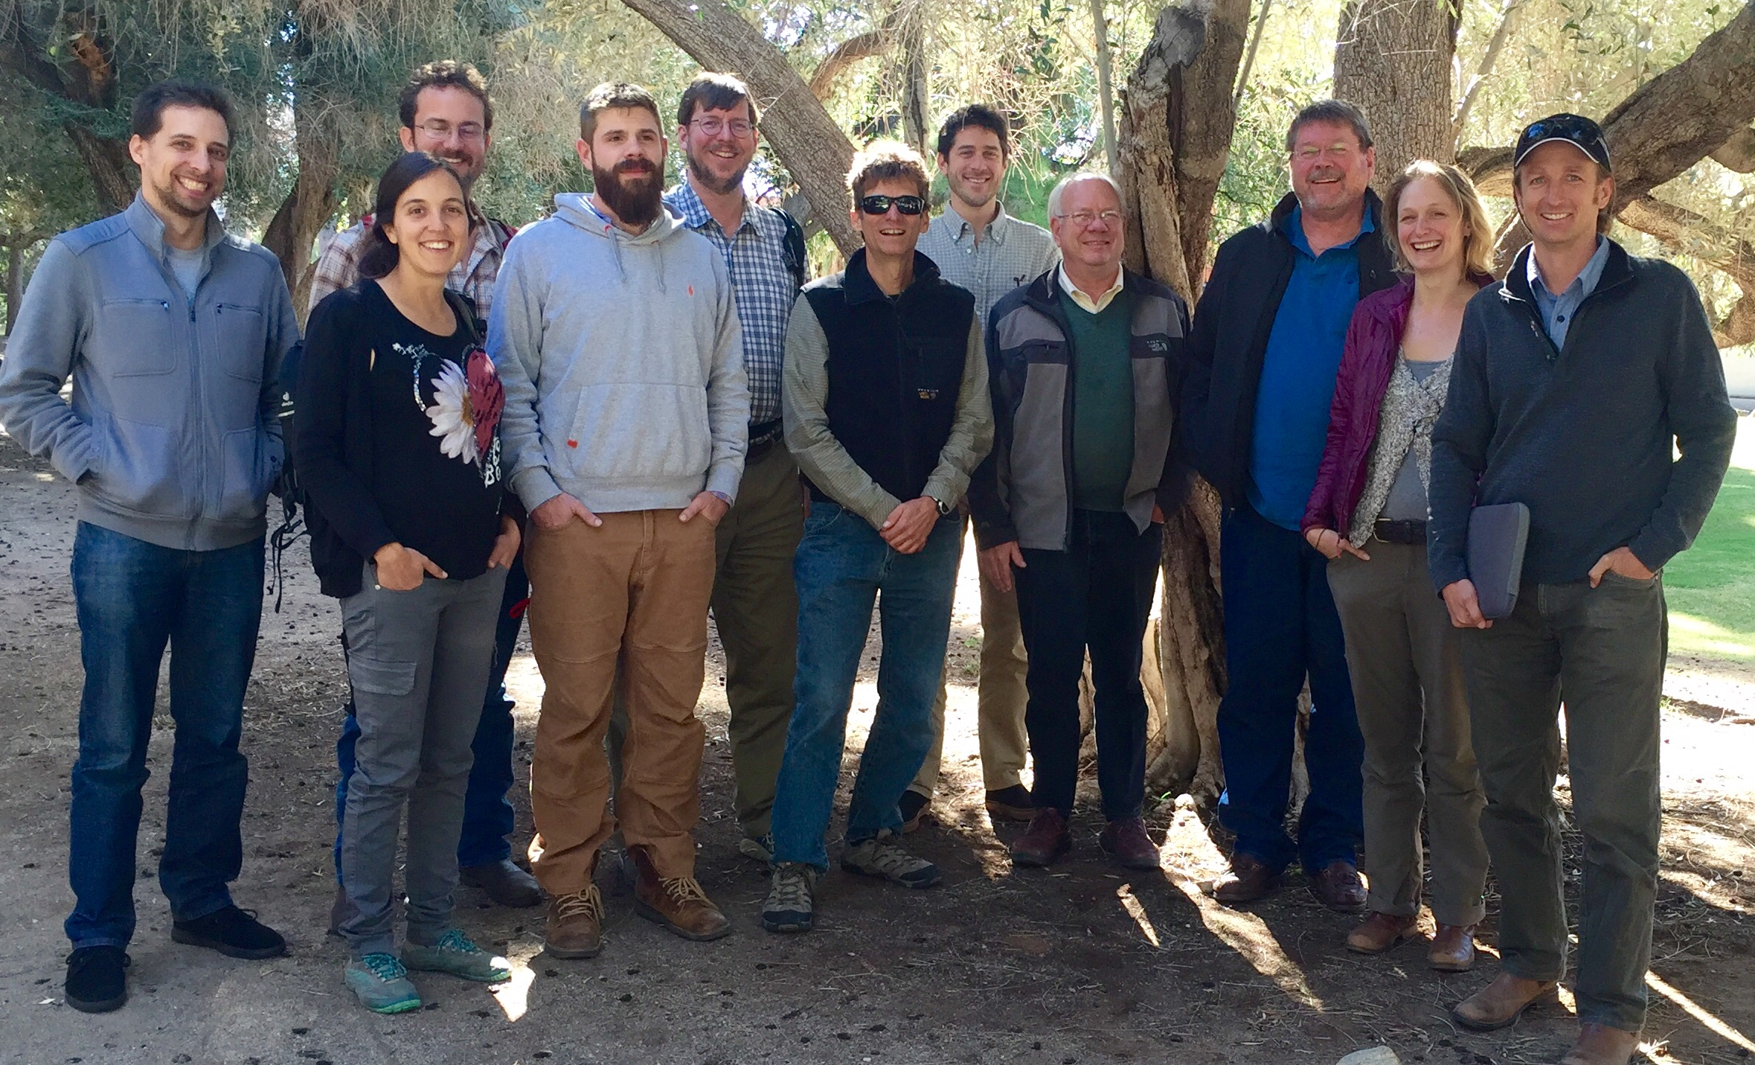
What is BIEN?
The Botanical Information and Ecology Network
Network of 50+ people at 20+ institutions
Ecologists
Evolutionary Biologists
Computer scientists
Informaticians
Collection managers
Taxonomists
and more…
1/5th of the BIEN group

Slide 8

The BIEN database
Additional validation:
Good coordinates?
Native?
Endangered?
Improved
Occurrence Data
Taxon scrubbing
Occurrence Data
Diverse data sources/formats
Plot Data
Trait Data
Range Maps
Phylogenetic Data
Taxonomic Data

Slide 9

The BIEN database
Additional validation:
Good coordinates?
Native?
Endangered?
Improved
Occurrence Data
Taxon scrubbing
Occurrence Data
Diverse data sources/formats
Plot Data
Trait Data
Range Maps
Phylogenetic Data
All of this is open-access and available!
Taxonomic Data

Slide 10
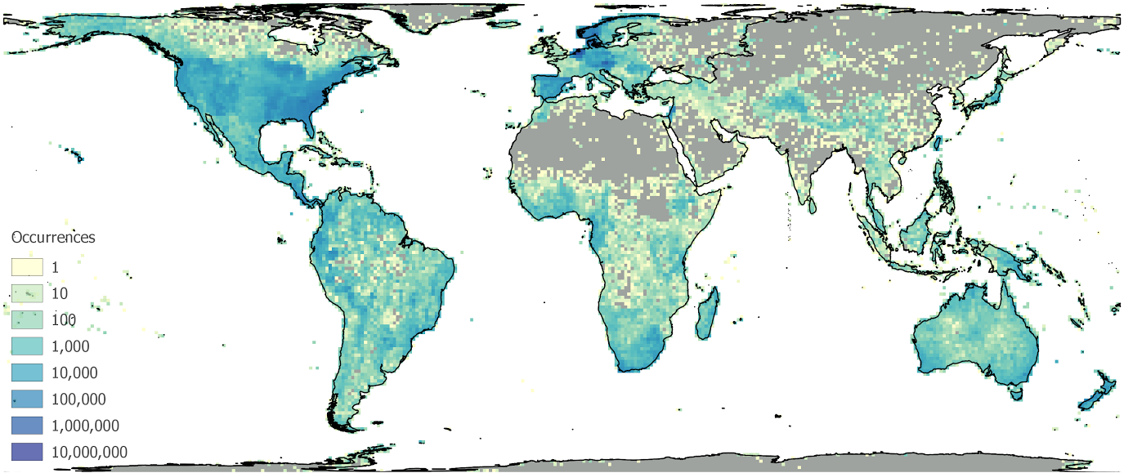
The BIEN database
 | Number observed within BIEN 3.4
Total Observations (Global) | 81,693,397
Specimens | 64,269,636
Plot observations | 17,423,761
Plots | 114,182
Species | 378,554
Trait measurements | 951,680
Ranges | 81,274
Taxonomic Data | 374,685
BIEN 3.4 Occurrence densities (per 100 km x 100 km cell)

Slide 11
The BIEN database
Accessing BIEN:
1) BIENdata.org
2) BIEN package for R (a.k.a. RBIEN)
3) POSTGRESQL

Slide 12

BIENdata.org

Slide 13
RBIEN: What is it?
A set of R functions to work with the BIEN database
Easier than learning SQL
Much easier than learning BIEN structure
Core goal of the package: make BIEN data easy to access

Slide 14
RBIEN: What is it?
Available on CRAN and Github
https://CRAN.R-project.org/package=BIEN
https://github.com/bmaitner/RBIEN
In R:
install.packages("BIEN")
install_github("bmaitner/RBIEN/BIEN")

Slide 15
RBIEN: What is it?
9 function families:
species lists
occurrence records
plot data
species range maps
trait data
taxonomic information
phylogenetic information
metadata
stem data

Slide 16
RBIEN: What is it?
9 function families:
species lists
occurrence records
plot data
species range maps
trait data
taxonomic information
phylogenetic information
metadata
stem data
Each family has a distinct prefix, e.g. :
BIEN_list_...
BIEN_occurrence_...

Slide 17
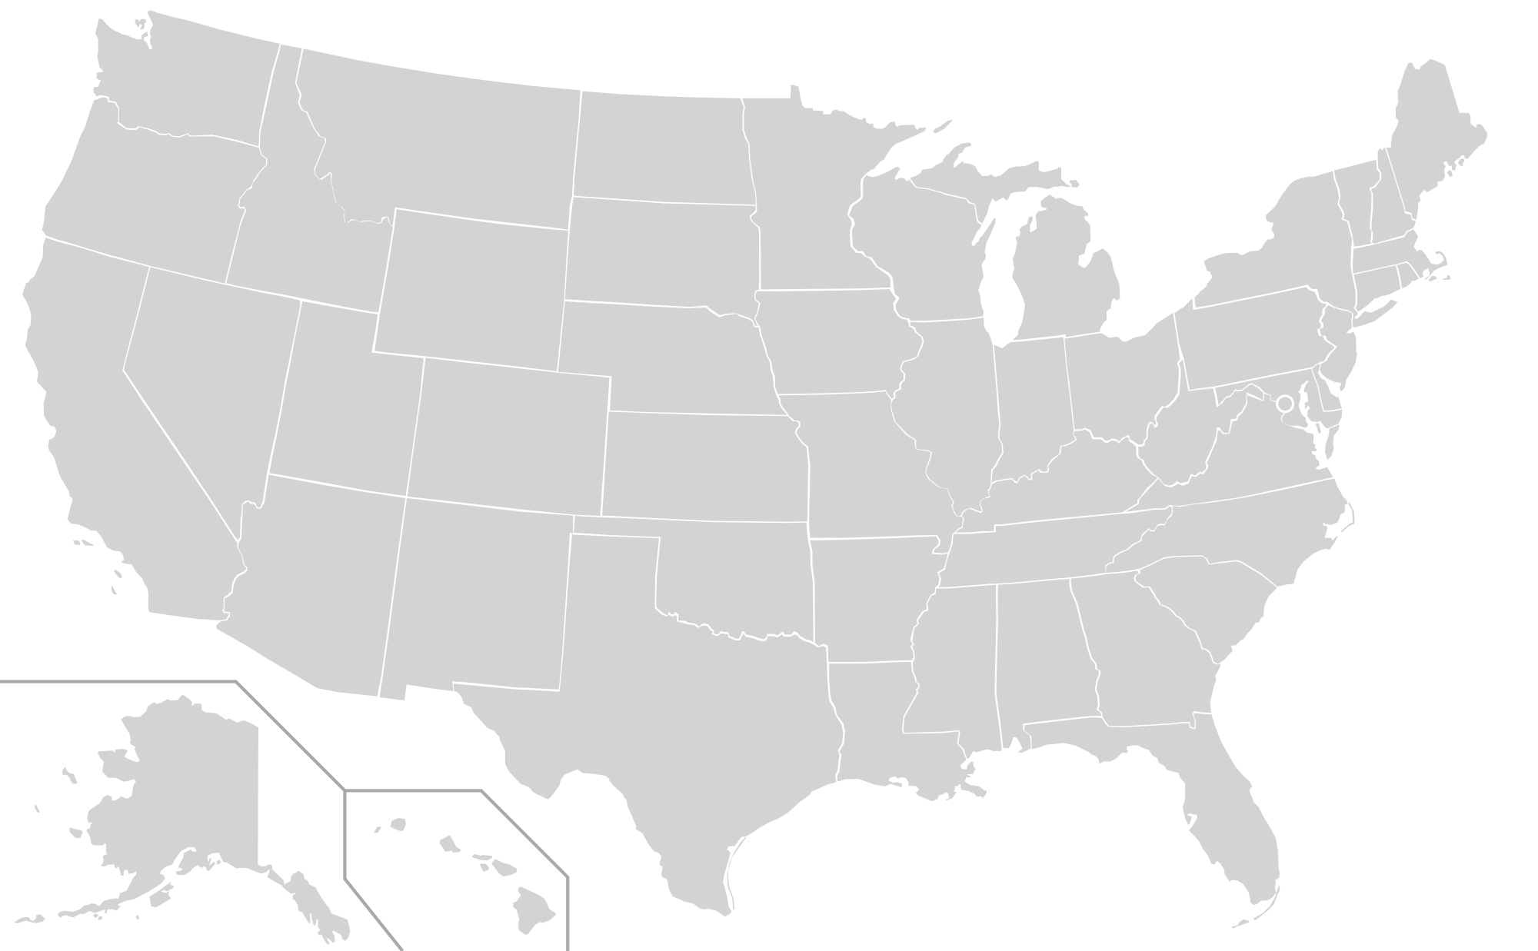
RBIEN: Species Lists
Prefix: BIEN_list_...
…all
…country
…state
…county
…shapefile

Slide 18
RBIEN: Species Lists
Prefix: BIEN_list_...
Example:
BIEN_list_county(country = "United States", state = "Arizona", county = "Pima")
Generates a list of all species with recorded occurrences in Pima county

Slide 19
RBIEN: Occurrence Records
Prefix: BIEN_occurrence_...
…country
…state
…county
…box
…shapefile
…family
…genus
…species
…records_per_species

Slide 20
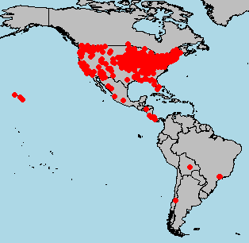
RBIEN: Occurrence Records
Additional options:
cultivated
only.new.world
natives.only
all.taxonomy
native.status
observation.type
political.boundaries
Restrict search,
provide more information
more information
Occurrences of a single species

Slide 21
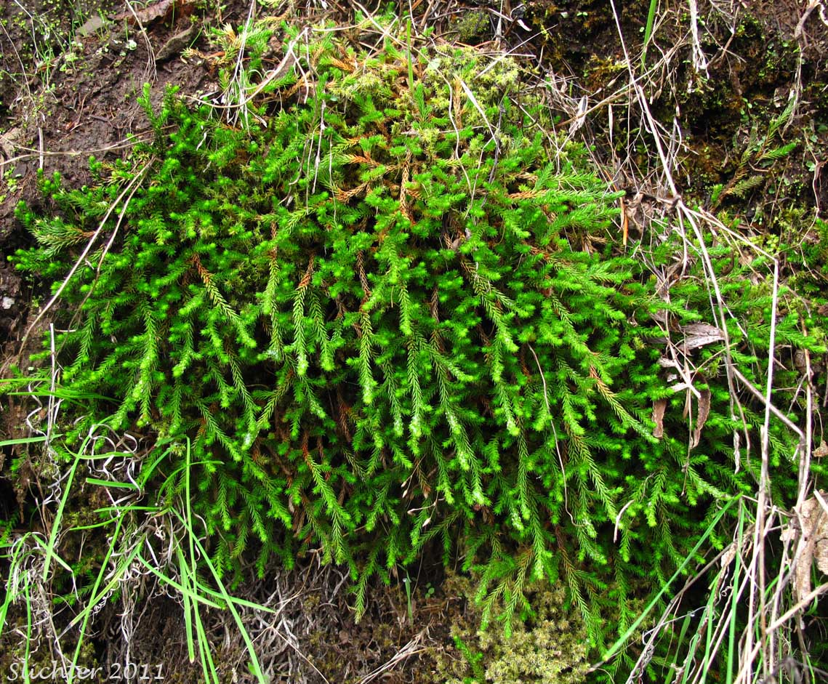
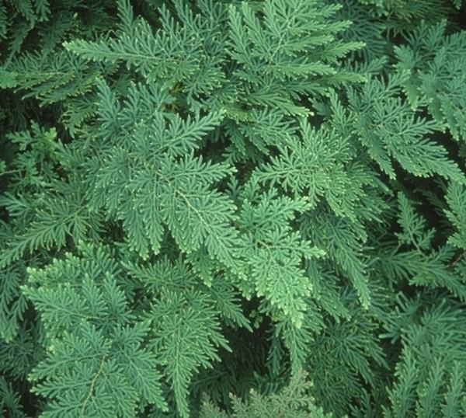
RBIEN: Occurrence Records
Example:
BIEN_occurrence_genus(
genus = "Selaginella",
only.new.world = F)
Downloads global records for Selaginella

Slide 22
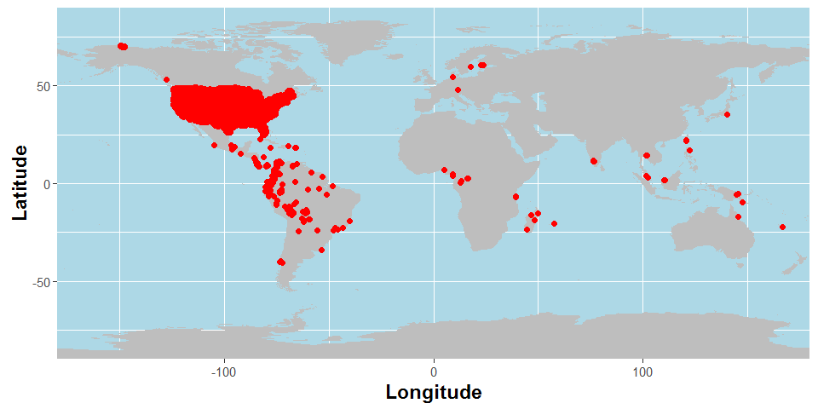
RBIEN: Plot data
Prefix: BIEN_plot_...
metadata
list_datasource
list_sampling_protocols
Good places to start with plot data
Useful info on which data meet your needs
Plot locations in BIEN 3.4

Slide 23
RBIEN: Plot data
Prefix: BIEN_plot_...
…dataset
…datasource
…sampling_protocol
…name
…country
…state
Plot locations in BIEN 3.4

Slide 24
RBIEN: Plot data
Additional options:
cultivated
only.new.world
natives.only
all.taxonomy
native.status
political.boundaries
all.metadata
more plot-specific metadata
Plot locations in BIEN 3.4

Slide 25
RBIEN: Plot data
Example:
BIEN_plot_state(
country = "United States",
state = "Rhode Island")
Plot locations in BIEN 3.4

Slide 26
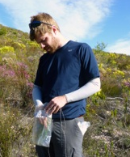

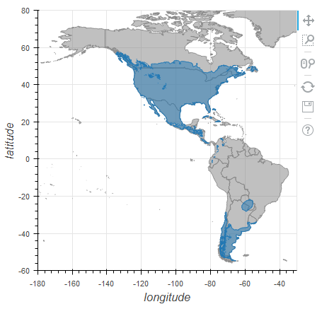
RBIEN: Species range maps
Prefix: BIEN_ranges_...
…genus
…species
…load_species
…intersect_species
…box
…shapefile
taxonomic queries
spatial queries

Slide 27
RBIEN: Species range maps
Prefix: BIEN_ranges_...
…genus
…species
…load_species
…intersect_species
…box
…shapefile
loads maps into
environment

Slide 28
RBIEN: Species range maps
Additional options:
directory
matched
match_names_only
return.species.list
species_names_only
crop.ranges
VERY IMPORTANT!

Slide 29
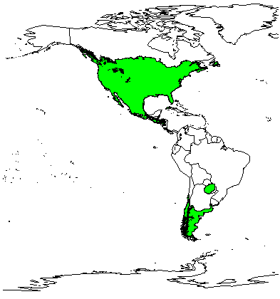
RBIEN: Species range maps
Example:
library(maps)
library(maptools)
xs<-BIEN_ranges_load_species(
species= "Xanthium strumarium")
map('world',xlim = c(-180,-20))
plot(xs, add=TRUE, col="green")

Slide 30

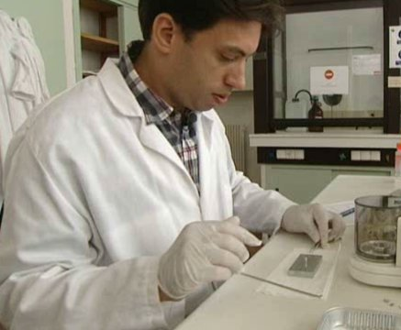
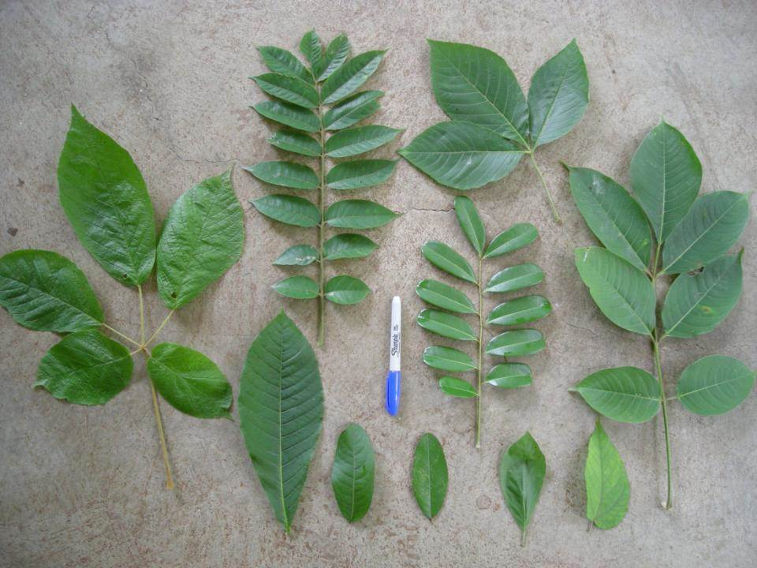
RBIEN: Trait Data
Prefix: BIEN_trait_...
…list
…trait
…traitbyfamily
…traitbygenus
…traitbyspecies
…traits_per_species
…mean
…family
…genus
…species
Image: catherinehulshof.wordpress.com

Slide 31
RBIEN: Trait Data
Prefix: BIEN_trait_...
…list
…trait
…traitbyfamily
…traitbygenus
…traitbyspecies
…traits_per_species
…mean
…family
…genus
…species
Useful metadata
trait queries
taxonomic queries
Image: catherinehulshof.wordpress.com

Slide 32
RBIEN: Trait Data
Start with BIEN_trait_list
Spelling matters
“leaf area” ≠ “Leaf Area”
Standardized names, units
31 traits (more to come)
Image: catherinehulshof.wordpress.com

Slide 33
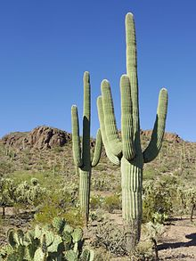
RBIEN: Trait Data
Example:
BIEN_trait_genus("Carnegiea")
Downloads all trait data for saguaros

Slide 34
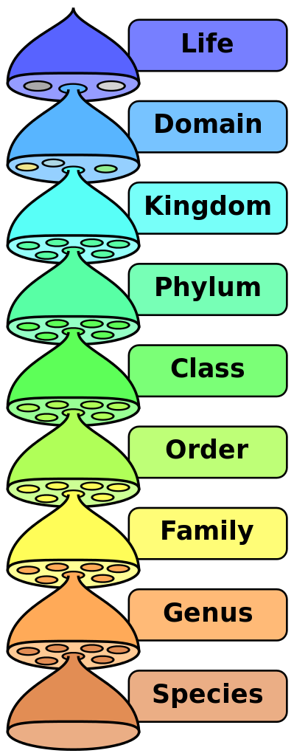
RBIEN: Taxonomic Data
Prefix: BIEN_taxonomy_...
…family
…genus
…species

Slide 35
RBIEN: Taxonomic Data
Prefix: BIEN_taxonomy_...
…family
…genus
…species
Also contains authorship, validity data

Slide 36
RBIEN: Taxonomic Data
Example:
BIEN_taxonomy_family("Selaginellaceae")
Downloads taxonomic data for the whole family

Slide 37


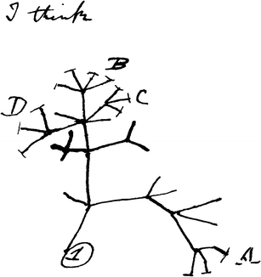
RBIEN: Phylogenies
Prefix: BIEN_phylogeny_....
…conservative
…complete

Slide 38
RBIEN: Phylogenies
Prefix: BIEN_phylogeny_....
…conservative
…complete
Only species w/ molecular data (19k), 1x
Most New World species (81k), 100x

Slide 39
RBIEN: Phylogenies
Prefix: BIEN_phylogeny_....
…conservative
…complete
Additional options:
n_phylogenies
seed
replicates
Only species w/ molecular data (19k), 1x
Most New World species (81k), 100x
Randomly select phylogenies
Specify phylogenies for download

Slide 40
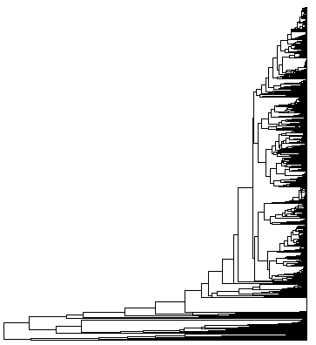
RBIEN: Phylogenies
Example:
phylo <- BIEN_phylogeny_conservative()
library(ape)
plot.phylo(phylo, show.tip.label = F)

Slide 41
RBIEN: Metadata
Prefix: BIEN_metadata_...
…database_version
…match_data
…citation

Slide 42
RBIEN: Metadata
Prefix: BIEN_metadata_...
…database_version
…match_data
…citation
Generates attribution data!
References
Acknowledgements

Slide 43
RBIEN: Metadata
Example:
selaginella <- BIEN_occurrence_genus("Selaginella")
BIEN_metadata_citation(dataframe = selaginella)
Returns:
1) Information on data use
2) Bibtex citations for use in a reference manager
3) Acknowledgement statement for manuscripts

Slide 44
RBIEN: Caveats and tips
Computer and network need to allow SQL connections
Some queries may take a long time, be patient
Let me know if something is documented poorly

